Slide 1
Construction Data Management system
BY Rejith Nair

Slide 2
Overview
This project aims to develop a comprehensive construction data management system, covering schema design, table creation, data insertion, and data analysis through MySQL.
The primary objective of this website/system is to furnish data to clients who pitch their products to contractors. We generate revenue through yearly subscriptions.
Clients have the ability to filter data according to their preferences and access counseling services from our company, contingent upon their subscription level.

Slide 3
Table Description
There are total 7 tables in this database:
1. "Construction Project": Stores information about construction projects, including project name, location, start date, and end date.
2. "Client": Contains details of clients accessing the system, such as client name, contact person, email, and phone number.
3. "Project Phase": Records different phases of construction projects with start and end dates.
4. "ProductS": Contains product id and product name with client id
5. "Contractor": Stores information about contractors involved in construction projects, including contractor name, contact person, email, and phone number.
6. "Subscription": Manages subscription details, including subscription type, start and end dates, and associated client or contractor.
7."CounseloR": Records details Such as counselor name and contact.

Slide 4
Entities:
  Contractor: Companies or individuals responsible for carrying out construction projects.
  Client: Entities that contract the services of contractors for construction projects.
  Counselor: Advisors or consultants who may assist clients or contractors with their projects or subscriptions.
  Project: Construction projects undertaken by contractors for clients.
  Project Phase: Different stages of a construction project, such as planning, construction, and finishing.
  Subscription: Service agreements between clients or contractors and the platform, offering various subscription types.
  Products: Displays the Products offered by the clients.
Relationships:
  Contractors undertake multiple projects, establishing a one-to-many relationship between contractors and projects.
  Each project can have multiple phases, forming a one-to-many relationship between projects and project phases.
  Clients can subscribe to various subscription types, forming a one-to-many relationship between clients and subscriptions.
  Counselors can be associated with multiple subscriptions, establishing a one-to-many relationship between counselors and subscriptions.
  Contractors and clients can have subscriptions, forming one-to-many relationships between contractors and subscriptions and between clients and subscriptions.
  There's a one-to-many relationship between clients and products, indicating that a client can offer multiple products.
Subscriptions:
  Subscription types include "Basic" and "Premium," each offering different services and features.
  Subscriptions may have start and end dates, along with associated amounts representing subscription fees.
  Clients and contractors can subscribe to different subscription types, providing access to platform services(counselors) and features tailored to their needs.

Slide 5
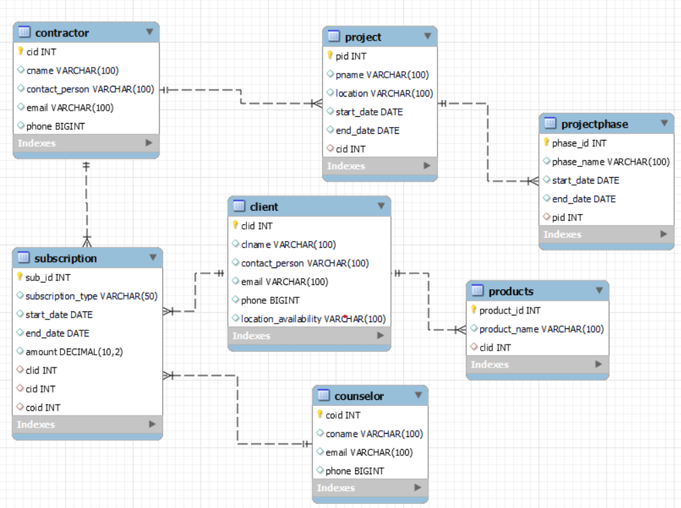
Database Schema:

Slide 6
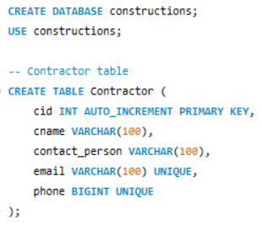
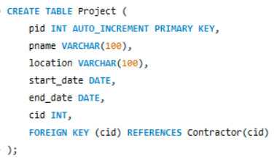
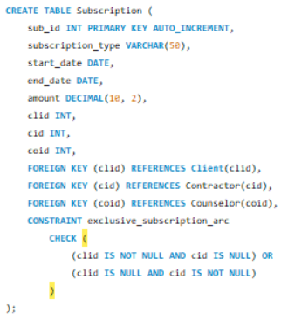
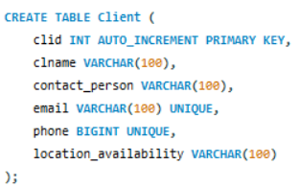
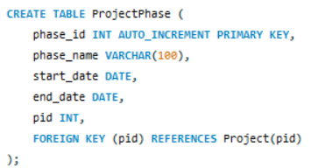
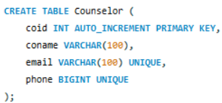
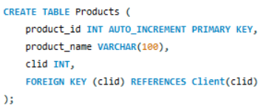
Creating the table and inserting values into the tables.

Slide 7
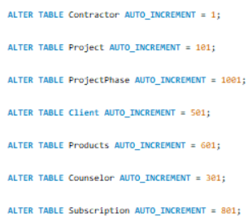
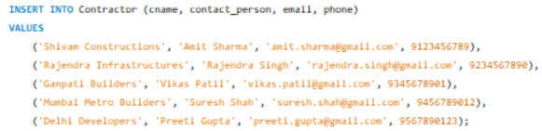
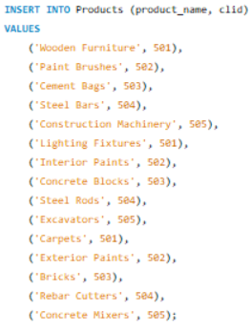
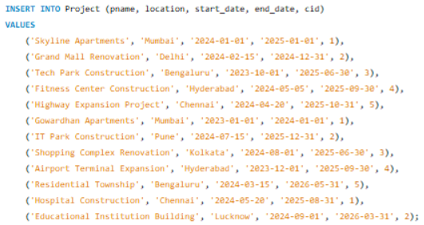
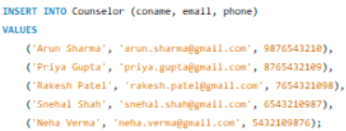
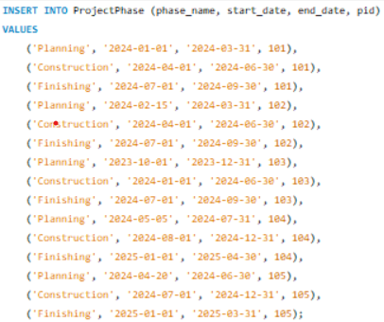
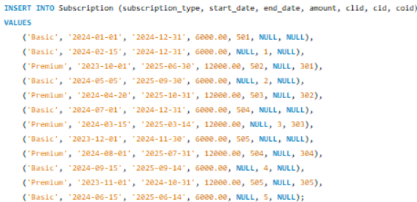
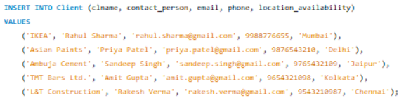

Slide 8

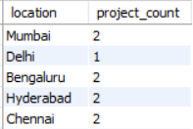

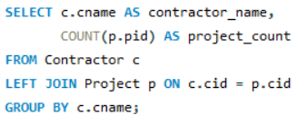
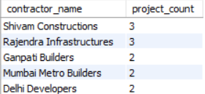
Data Analysis:
1. Count of projects by location.
2. Average Project duration in months
3.Number of Projects for Each Contractor

Slide 9
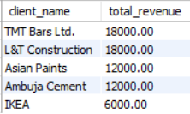
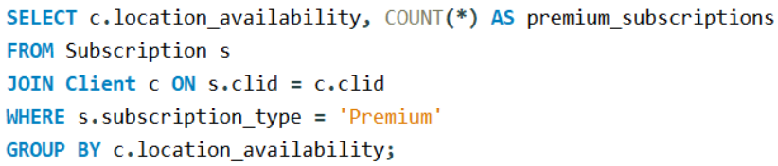
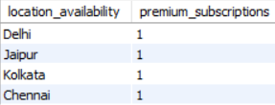
4. TOP 5 clients by revenue
5. Number of premium subscribers by location

Slide 10
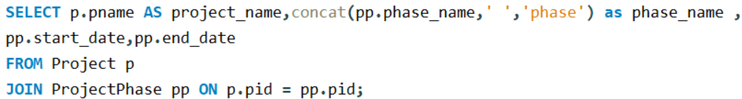
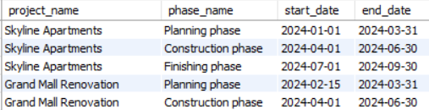
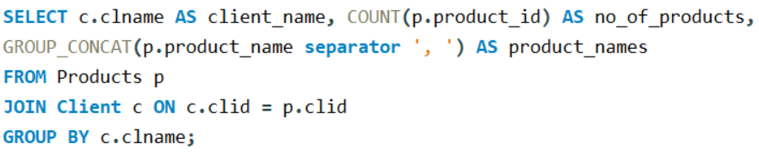
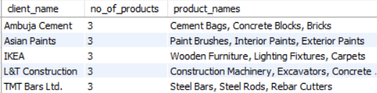
6. Displaying phase information with project name.
7. Displaying the total no of products and product names by client .

Slide 11
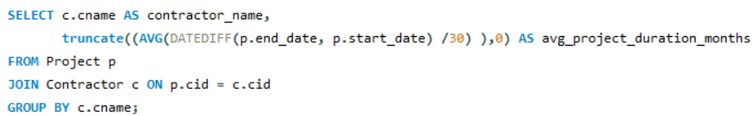
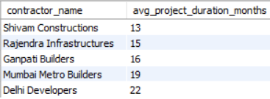
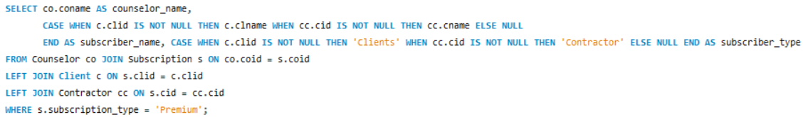
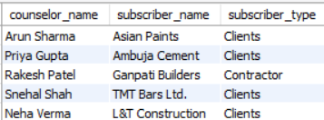
8. Displaying average duration taken by contractors to complete their project.
9. Displaying counselor along with their subscribers and subscriber_type.

